Slide 1
Education Accreditation Programs and Educational Development in Region 9 Countries
Tariq Durrani, VP Educational Activities
Doug Gorham Managing Director EAD
IEEE Region 9
7 April 2011
Salvador, Bahia, Brazil

Slide 2
Thursday 7 April 2011 16.10-16.40 pm.
TRACK C Salon A
Development of Accreditation Programs in R9 countries.

Slide 3
University Level Activities
T
Accreditation Outside the US

Slide 4
University-level Activities
Objectives:
Improve academic curricula and ensure their purposeful adaptation to the changing technical and business climate
Improve delivery and effectiveness of engineering education
Improve retention of engineering and technology students

Slide 5
Our Request
The R9 Committee agrees to work with IEEE EAB to investigate the need, benefits, processes and resources needed to establish an Accreditation Advisory Board for Latin America

Slide 6
Accreditation Advisory Board and Supporting Organisations
Advisory
Board
Country
1
Country 2
Org.3
Org 4

Slide 7
Sample Accrediting Advisory Board Components
A Board of Directors:
IEEE members and
Representatives of National Accreditation Boards
Subcommittees responsible for advice on:
Creating accreditation criteria
Program evaluator recruitment and training
Finance
Governance
Operations
Administrative Staff

Slide 8
Why an Accrediting Advisory Board for Latin America? (1)
Providing various forms of support to entities and individuals in a single country or a small group of countries that wish to create an accrediting body, to include:
informing key constituents about the meaning and significance of program accreditation
facilitating meetings of academic, business and/or government organizations with a shared interest in accreditation

Slide 9
Why an Accrediting Advisory Board for Latin America? (2)
assisting in the design of accreditation criteria and procedures
helping develop processes to identify and train volunteers to serve as evaluators on campus visit teams and on accreditation policy committees
helping develop organizational governance structures
helping to develop their own evaluators and/or interchange evaluators with other countries

Slide 10
Why an Accrediting Advisory Board for Latin America? (3)
Providing support, as needed, to existing independent accrediting agencies
Sponsoring and/or facilitating region-wide dialog and cooperative activities on accreditation, to include:
Organizing efforts to create mutual recognition agreements among member organizations,
helping to find program evaluators from outside one nation when conflict of interest requirements cannot be resolved within a country.

Slide 11
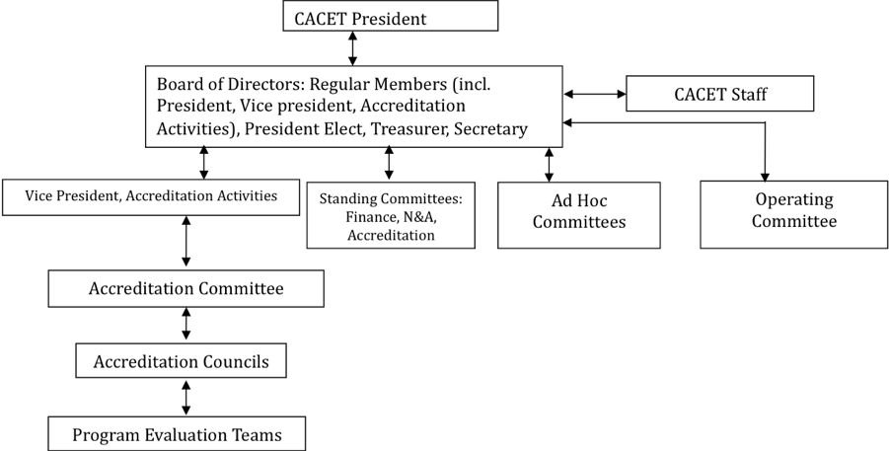
Sample Organizational Structure

Slide 12
Questions or comments?

Slide 13
Why Program Accreditation? (4)
Facilitate the evaluation and transfer of course credits and other academic credentials across geographic boundaries
Assuring employers, graduate admissions officers and some licensing bodies in other nations about the integrity of degrees awarded by an accredited institution in the “home” country
Creating a culture of continuous improvement

Slide 14
IEEE’s Role in Accreditation (1)
IEEE considers accreditation a key vehicle to ensure active involvement of the Institute in maintaining the quality and relevance of an engineering, computing and technology education
IEEE seeks a leadership role in program accreditation within all the areas of its technical activities

Slide 15
IEEE’s Role in Accreditation (2)
IEEE seeks leadership in accreditation worldwide
Including support in development and administration of accrediting bodies
IEEE seeks to develop and support local accrediting bodies where such bodies do not exist at the present time

Slide 16
EAB’s Recent Accreditation Projects
Development of IEEE’s policy on accreditation
Development of a comprehensive on-line resource on accrediting bodies and mutual recognition agreements
Assistance to emerging accrediting bodies and accreditation projects worldwide:
China, the Caribbean, and Peru

Slide 17
Inventory of Activities
Regional workshops on trends in accreditation
In the past: Bangkok, Bratislava, Helsinki, Lima
- Nomenclature Workshop in Lima
Assistance to existing accrediting bodies
Formation of new accrediting bodies
“follow the volunteers”
Address all aspects of ECT

Slide 18
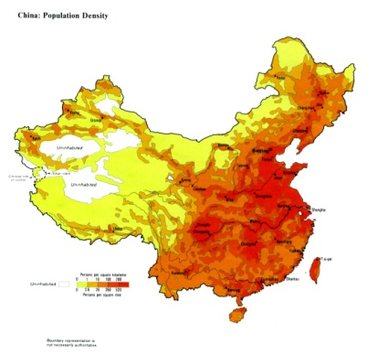
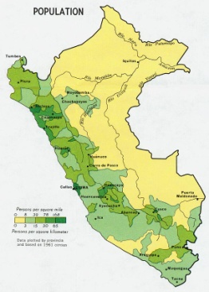
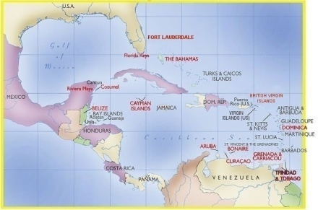
Where do we operate now? (1)
Ongoing Areas:
China: “Working Group on Education in China” with the Ministry of Education and China Association of Science and Technology (CAST)
Peru: ICACIT, evaluation visits are happening
The Caribbean: new accrediting body for programs taught in English (CACET)

Slide 19
Where do we operate now? (2)
Work in progress areas include:
India, in conjunction with the National Accreditation and Assessment Council
Middle East, involving 6-7 countries
5-7 countries in southern/eastern Africa
Computing nomenclature effort in Region 9

Slide 20
Where do we operate now? (3)
Future possibilities:
Thailand
Spain
Advise/support on Region/continent wide accreditation in Latin America
ARCU-SUR on IEEE Fields of Interest (engineering & technology).
Indonesia

Slide 21
Why Program Accreditation? (1)
Help Institutions:
- assess the quality of their engineering, computing and technology degree programs
- develop and apply their own strategies for continuous program improvement
Provide opportunities for Industry to:
- reflect their particular needs and expectations for the knowledge and skills of new graduates
- participate in the formation and application of accreditation criteria

Slide 22
Why Program Accreditation? (2)
Allow Nations to seek membership in various global accords that support the mutual recognition of degree programs in engineering, computing and technology
Enable cross-national academic program alliances and partnerships
For individual student -Ease of admission to Masters Degree Program when coming from an Accredited undergraduate program

Slide 23
Why Program Accreditation? (3)
Facilitating the movement of faculty, students and ideas more easily among institutions and across national boundaries
Providing assurance to:
- prospective students and parents that a degree program has met threshold quality standards for curriculum content, admission and degree requirements, and institutional stability
- prospective faculty that a program has adequate financial and intellectual resources to support its stated mission

